Slide 1
Artificial Intelligence (AI)
Topic 1: Understanding Repast Symphony and Agent Modelling

Slide 2
Agenda
Agent Based Modelling
Agent Types
About Repast Symphony
Example : Predator- Prey Agent Modelling
Learning Outcomes : Intelligent Agents
Methodology and Assessment Criteria for the Subject

Slide 3
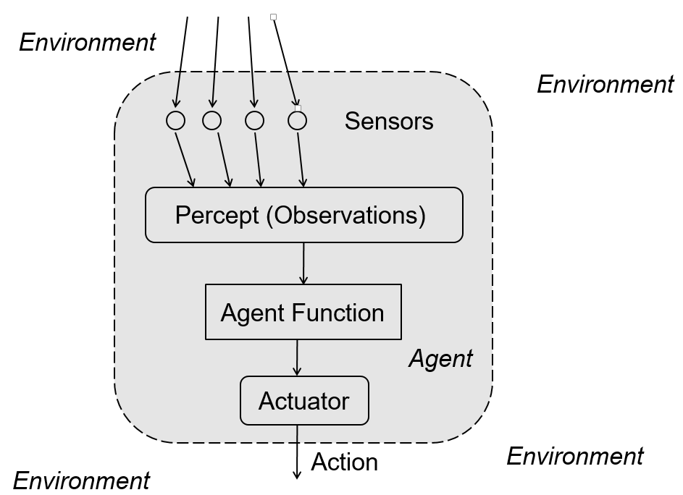

Slide 4
PEAS : Automated Taxi Driver
Agent Type | Performance Measure | Environment | Actuators | Sensors
Taxi | Safe, Fast, Legal, Comfortable trip, maximise profits | Roads, Pedestrians, Customers, other traffic | Steering, accelerator, break, signal horn, display | Cameras, Sonar, speedometer, odometer, GPS, Accelerometer, Engine Sensors, Keyboard

Slide 5
What is Agent Based Modelling (ABM) (1)
An entity that functions continuously and autonomously in an environment in which other processes take place and other agents exist
Simulation modeling technique where a system is modeled as a collection of agents and the relationships between them.
Agents individually asses its situation in the environment and make decisions on the basis of a set of rules

Slide 6
What is Agent Based Modelling (ABM) (2)
General Characteristics of an Agent :
Autonomy
Pro-activeness
Reactivity
“Social” Ability

Slide 7
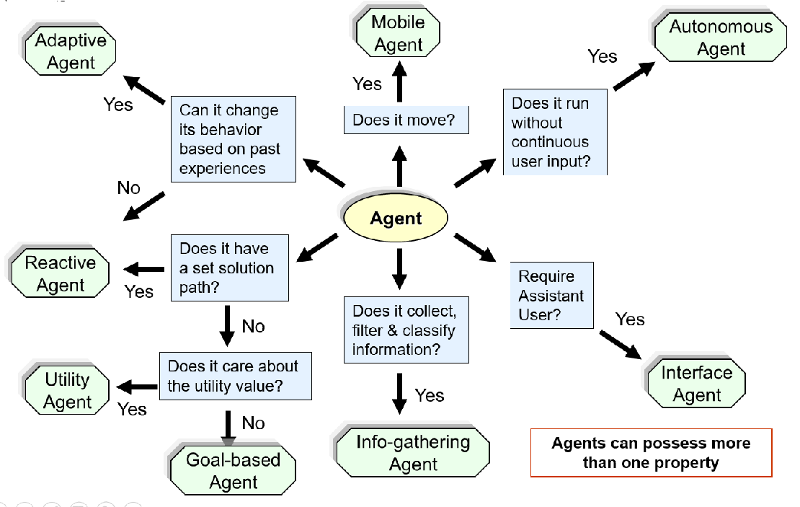
Agent Types

Slide 8
A Case Study for Multi – Agents (1)
We implement a model of Wolf-Sheep predation in Repast Symphony
This model represents a simple variation of predator prey behavior using three agents:
- Wolf
- Sheep
- Grass

Slide 9
A Case Study for Multi – Agents (2)
Both the Wolf and sheep move in the grid randomly and some energy is lost. The wolves and sheep need to eat food in order to replenish their energy, and they will die once their energy level reaches zero.
Wolves prey on sheep and may eat them if the two are located in the same spatial position, thereby increasing the wolf’s energy level
Sheep may similarly eat grass if the sheep is located on a patch which contains living grass.
Once a sheep eats the grass in its location, the grass needs to regrow before the sheep can eat it again

Slide 10
A Case Study for Multi – Agents (3)
Repast Symphony models a re-grow rate for grass by counting down after the grass has been eaten in a specific location
Reproduction is modeled by a random process that creates a child from the parent, divides the energy of the parent agent in half, and assigns the energy equally to the parent and child.

Slide 11
Repast S Implementation (1)
The Repast S implementation of the wolf-sheep predation model consists of several classes of interest, which include, specifically, the data loader and agent classes.
The context creator class, which implements DataLoader, constructs the main context and returns it to the Repast run environment
Within the user-designed context creator, modelers create a root context and add the desired agents and projections to the context. In this example, we add a Grid projection to the context to model the world using a discrete Cartesian grid.
Next, we add the agents (i.e., the wolf, sheep, and grass) to the context and set the parameters for Simulation in the GUI

Slide 12
Repast S Implementation (2)
. The agent moves by randomly selecting one of the nearest eight neighboring grid positions (i.e., the agent’s Moore neighborhood).
The three agent classes in the model extend the SimpleAgent class, which contains common methods related to movement and death including the Scheduling for each Agent to Carry out its function
Movement on the grid is accomplished by the move method
The agent moves by randomly selecting one of the nearest eight neighboring grid positions (i.e., the agent’s Moore neighborhood).
The “die” method occurs when either the agent’s energy level reaches zero, or in the case
of sheep, when the agent is eaten. We model the death process by simply removing the
agent from its context

Slide 13
Repast S Implementation (3)
. The agent moves by randomly selecting one of the nearest eight neighboring grid positions (i.e., the agent’s Moore neighborhood).
The Wolf Class step method overrides the Simple Agent includes :
- moving,
- reducing energy,
- catching sheep,
- reproducing, and
- dying
A wolf may catch a sheep to eat if a sheep exists on the same grid coordinate as the wolf. The wolf agent obtains the Grid object from its context and scans through the objects at its location
If there is a sheep at the wolf’s location, the wolf eats the sheep and increases its energy according to the gain set in the parameters

Slide 14
Repast S Implementation (4)
. The agent moves by randomly selecting one of the nearest eight neighboring grid positions (i.e., the agent’s Moore neighborhood).
Repast S models reproduction by a random process which generates a random number, and if the number is less than the wolf reproduction rate, a new wolf is created. The energy level of the parent is halved and given in equal parts to the parent and child.
Sheep behavior is very similar to wolf behavior and is specified in the Sheep class only the manner to acquire energy is different where the grass has to be alive and located as soon as the sheep scans the location. If alive after the sheep eats the grasses state is switched from dead to alive
Grass Agent class also overrides the simple agent and initiates a counter for the regrowth.

Slide 15
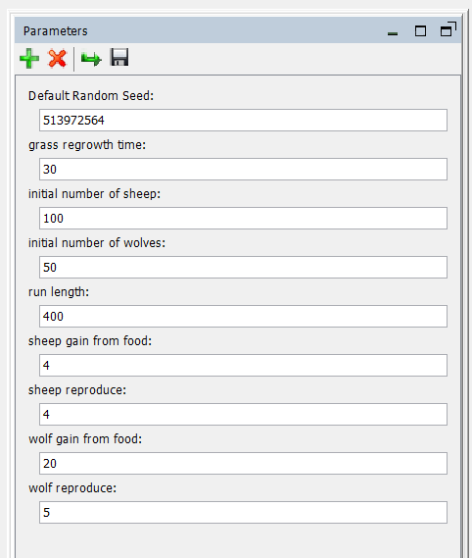
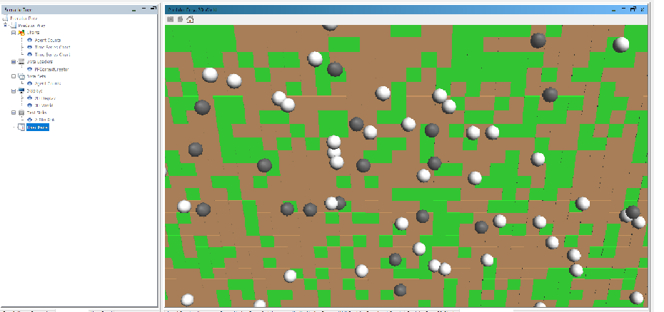
Repast S Implementation (5)
. The agent moves by randomly selecting one of the nearest eight neighboring grid positions (i.e., the agent’s Moore neighborhood).
The step method simply checks whether or not the grass is dead. If it is, the step method reduces the re-grow timer or switches the state of the grass to alive if the timer has expired. If the grass is alive, the step method does not execute any code.

Slide 16
Class Discussion
Let us determine the Agent Type and the Task Environment and PEAS for the Agents here

Slide 17
Learning Outcomes with the Topic
Understanding of Task Environments
Designing an Agent

Slide 18
Methodology And Assessment Criterias
Class Assignment(s)
Each chapter being covered will have one assignment. The Case Studies will be given in line to the Changing with Speed across IT Projects in Kirirom
Internal Exam(s)
There will be 2 exams
Model Exam
There will be one Model Exam.
Semester Exam
There will be 1 Semester Exam

Slide 19
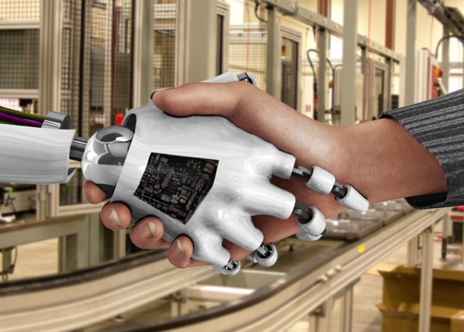
Thank You !
“Liberty according to metaphysics is self-determining power in an intellectual agent. It implies thought and choice and power
- John Adams “

